Slide 1
Prototyping & UI Mockups: Hands-On with Figma and Visily
A Workshop for Software Engineers

Slide 2
Agenda
Introduction to Prototyping & UI Mockups
Overview of Figma
Overview of Visily
Hands-On Activity
Q&A and Wrap-Up

Slide 3
What Are Prototyping and UI Mockups?
Prototyping: Creating interactive models to test user flows.
UI Mockups: Static visual representations of a final design.
Importance:
Visualize ideas early.
Test usability before development.
Enhance collaboration between designers and developers.

Slide 4
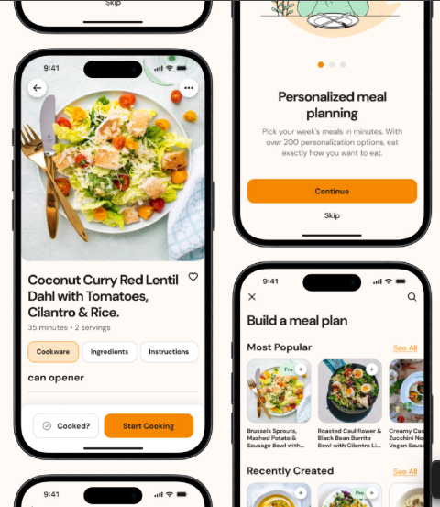
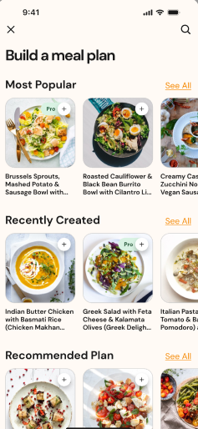
Examples
https://www.figma.com/design/dXOnFL2Ml1cBkkemZyJYCl/Recipe-App-UI-Kit-(Community)?node-id=0-1&t=TXTkTaQKju8JAG4z-1

Slide 5
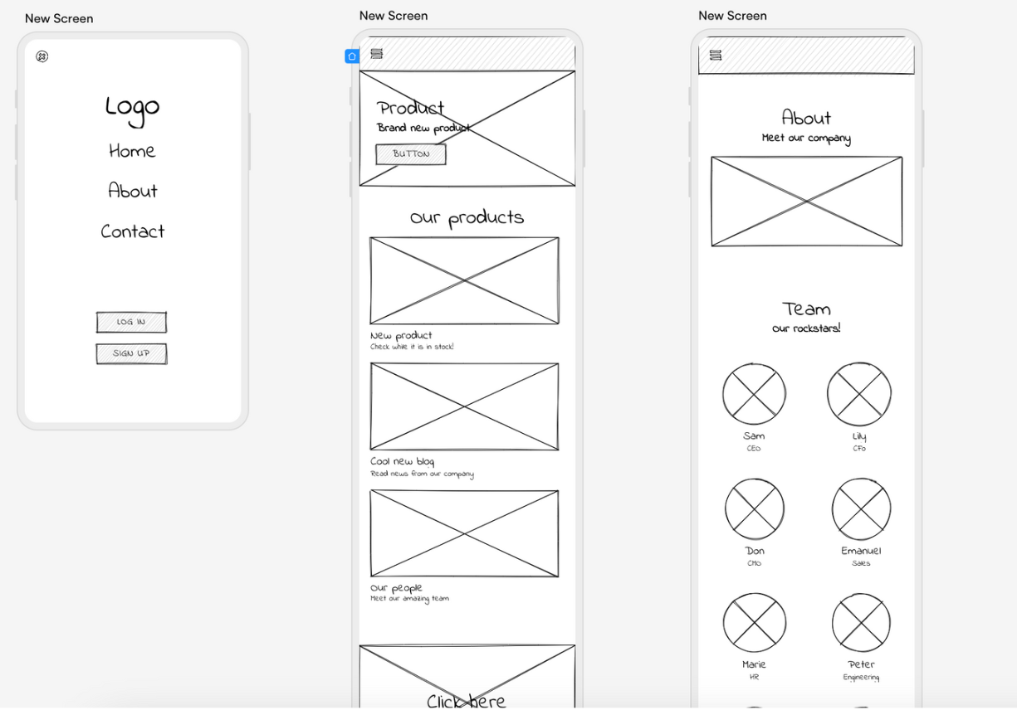
Wireframe
A wireframe acts as a low-fidelity blueprint for UI designs such as websites and apps.

Slide 6
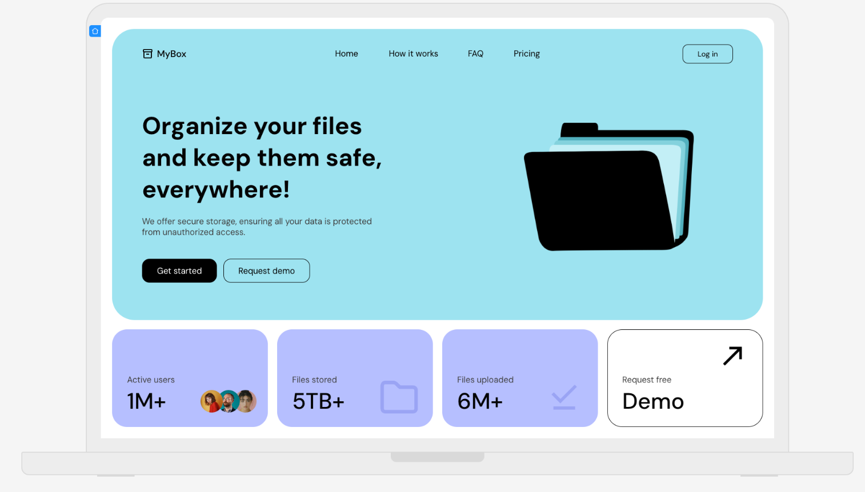
UI Mockup
A mockup is a medium-fidelity visualization of a UI design, such as a website or app.

Slide 7
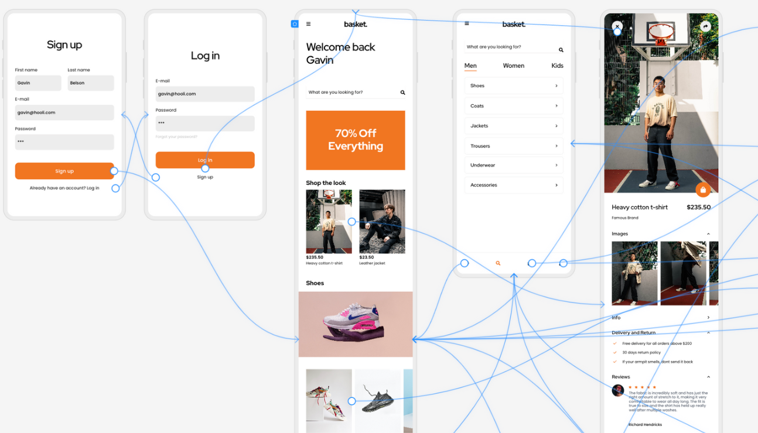
Prototype
A prototype is the closest step in the design process to a finished digital product. Prototypes demonstrate aesthetics, and functionality, whilst showing how users would interact with a website or app

Slide 8
Why Use Tools Like Figma and Visily?
Save time with pre-built templates and components.
Collaborate in real-time with team members.
Iterate quickly with feedback loops.
Create both static mockups and interactive prototypes.
Leverage AI to Generate UI Components: - Use text-to-design tools - transform hand-drawn sketches or screenshots into editable designs - Generate multi-screen prototypes or polished components from natural language prompts

Slide 9

Visily Overview
Key Features:
AI-powered tools like Screenshot-to-Design and Sketch-to-Design.
Drag-and-drop interface with pre-built templates.
Built-in themes, color palettes, and smart components.
Export designs to Figma or other formats.
Ideal For:
Beginners or non-designers needing quick results.
Teams prioritizing speed over pixel-perfection.

Slide 10
Visly Demo
https://app.visily.ai/projects/8d6cb7f9-cd2c-41c4-b292-5667f0c05273/boards/1578543
Use AI to convert a hand-drawn sketch into a mockup.
Customize the design with pre-made components (e.g., buttons, menus).
Add interactivity (e.g., clickable navigation).

Slide 11
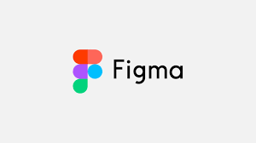
Figma Overview
Key Features:
Cloud-based collaboration.
Advanced prototyping with animations.
Plugins for extended functionality (e.g., Mockuuups Studio).
Cross-platform (browser, macOS, Windows).
Ideal For:
Teams needing pixel-perfect designs.
Advanced prototyping workflows.

Slide 12
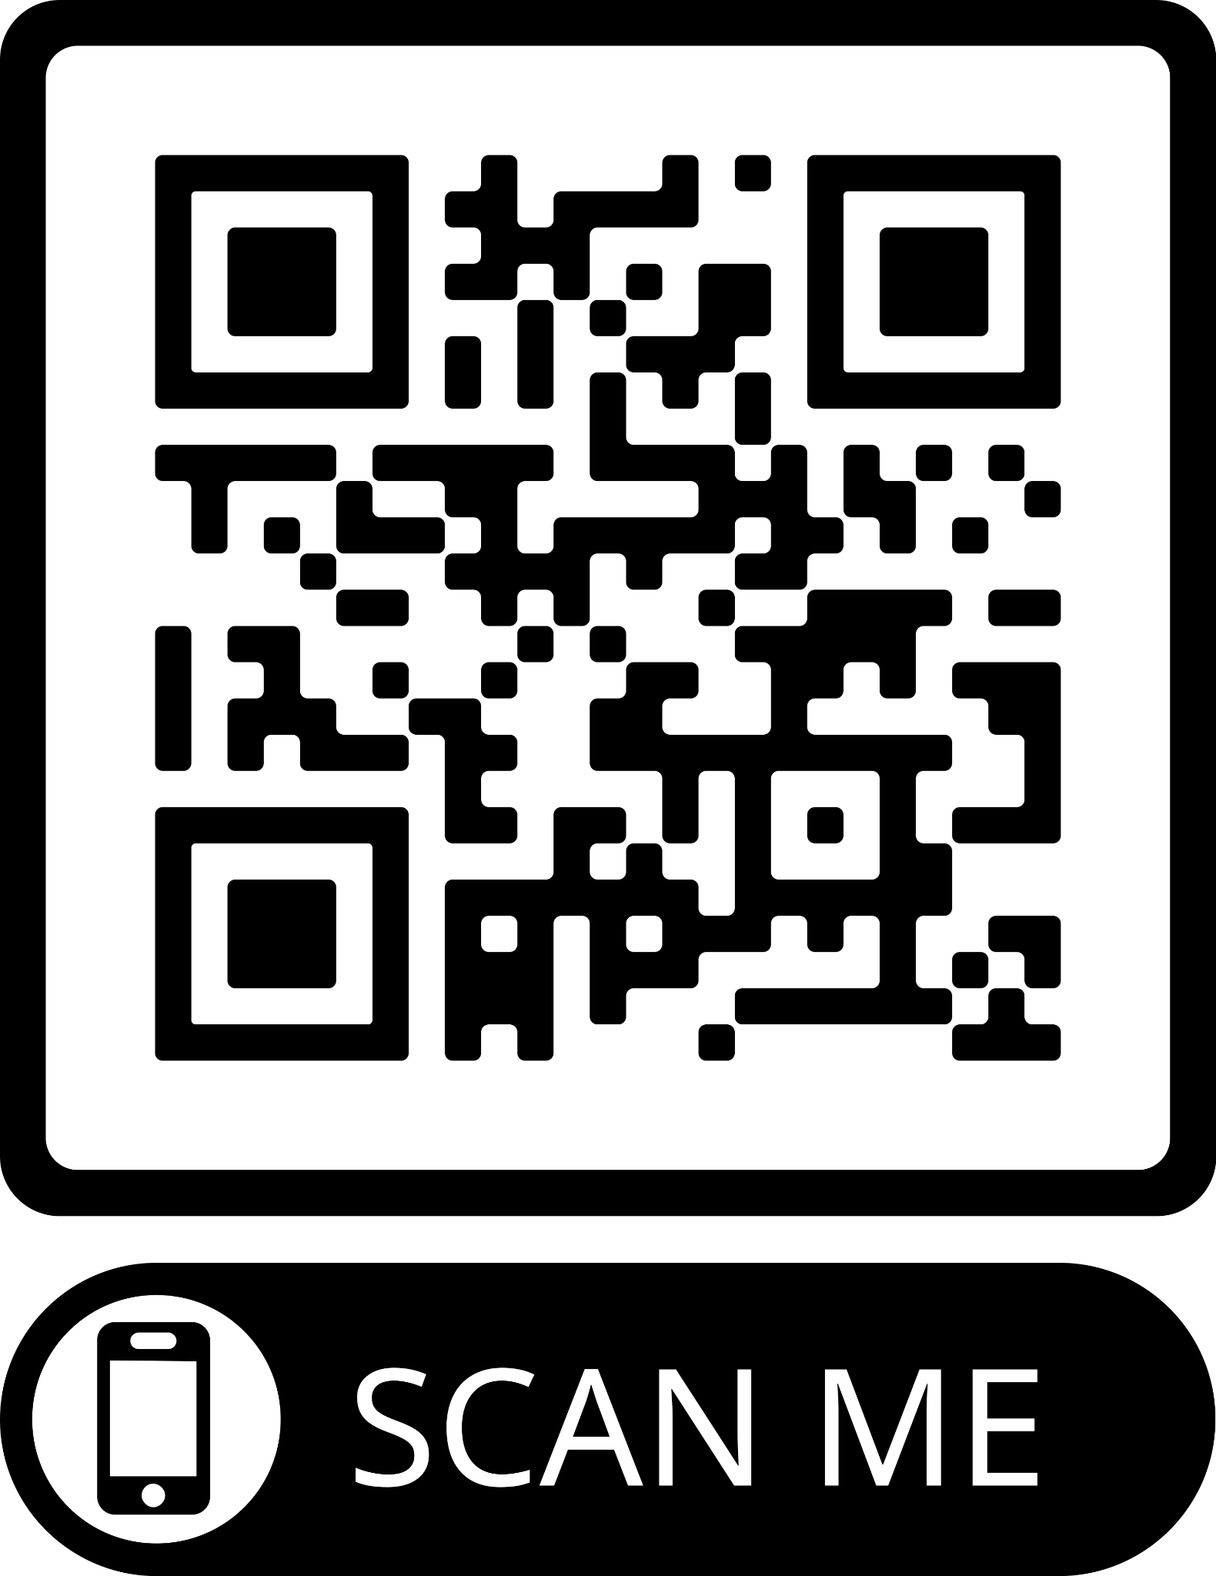
Figma Guided Activity
https://youtu.be/CQw9pjonUxs
https://www.figma.com/community/file/1464344494838081484
Create a wireframe for a mobile app login page.
Add interactivity (e.g., linking buttons to other screens).
Use Auto Layout for responsive design.
Preview the prototype.

Slide 13
Hands-On Activity Instructions
Objective: Apply what you’ve learned by designing an app prototype using Figma or Visily. Form groups of 2 or work individually.
Choose one of the following app ideas to design:
Wildfire Tracker App: Build an app to track California wildfires, including features like a map, alerts, and safety tips.
Dating App: Design a dating app with a user profile page, a match screen, and a messaging interface.
Social Media App: Create a social media app with a feed, user profile, and post creation features.

Slide 14
Wrap-up
Figma is ideal for advanced prototyping and pixel-perfect designs.
Visily is great for rapid mockups and beginner-friendly workflows.
Why Do We Prototype Before Developing the Product?
Validate Ideas Early
Identify Design Flaws
Improve Collaboration and align with stakeholders
Save Time and Resources
Enhance User Experience
Communicate Effectively: Prototypes act as a bridge between technical teams and non-technical stakeholders, making it easier to convey ideas.

Slide 15
Resources
https://www.figma.com/prototyping/
https://uizard.io/blog/wireframe-vs-mockup-vs-prototype/#what-is-a-wireframe
https://www.figma.com/best-practices/five-ways-to-improve-your-prototyping-workflow/
https://www.visily.ai/
https://www.visily.ai/help-center/create-folders-and-boards/

